Slide 1
Blind Test Healthy vs Breast Cancer Plasma Samples based on Exosome count using PANORAMA

Slide 2
Experimental Details for Blinded Healthy and Breast Cancer Plasma Samples
Used samples: 131-143 Blinded.
Plasma volume: 20 µl.
Type of Cancer: unknown.
Concentration: unknown.
Size Distribution: unknown.
Experimental duration: 60 min.
Antibody used: CD9, CD81, and CD63.

Slide 3
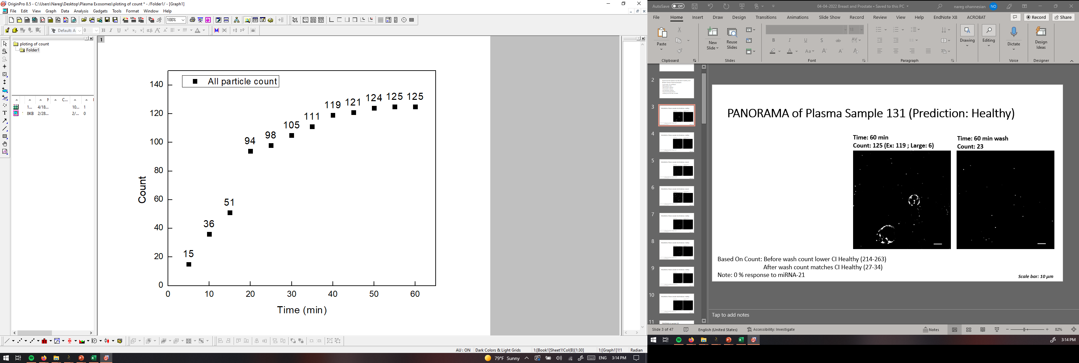
PANORAMA of Plasma Sample 131 (Prediction: Healthy)
Time: 60 min
Count: 125 (Ex: 119 ; Large: 6)
Time: 60 min wash
Count: 23
Based On Count: Before wash count lower CI Healthy (214-263)
After wash count matches CI Healthy (27-34)
Note: 0 % response to miRNA-21
Scale bar: 10 µm

Slide 4
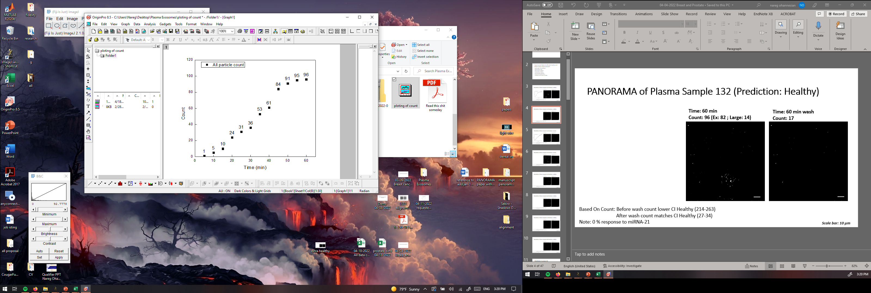
PANORAMA of Plasma Sample 132 (Prediction: Healthy)
Time: 60 min
Count: 96 (Ex: 82 ; Large: 14)
Time: 60 min wash
Count: 17
Based On Count: Before wash count lower CI Healthy (214-263)
After wash count matches CI Healthy (27-34)
Note: 0 % response to miRNA-21
Scale bar: 10 µm

Slide 5
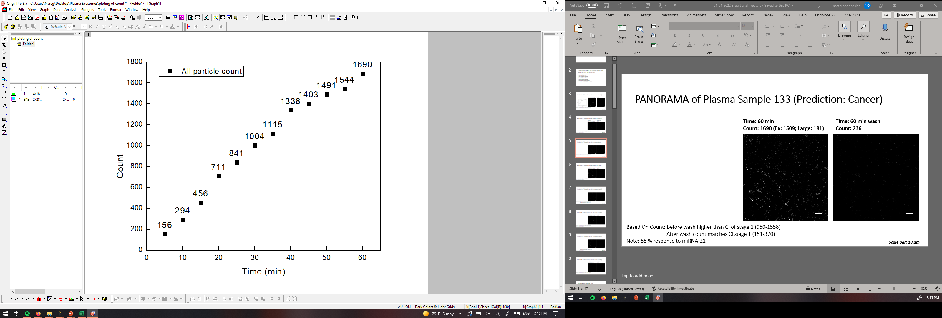
PANORAMA of Plasma Sample 133 (Prediction: Cancer)
Time: 60 min
Count: 1690 (Ex: 1509; Large: 181)
Time: 60 min wash
Count: 236
Based On Count: Before wash higher than CI of stage 1 (950-1558)
After wash count matches CI stage 1 (151-370)
Note: 55 % response to miRNA-21
Scale bar: 10 µm

Slide 6
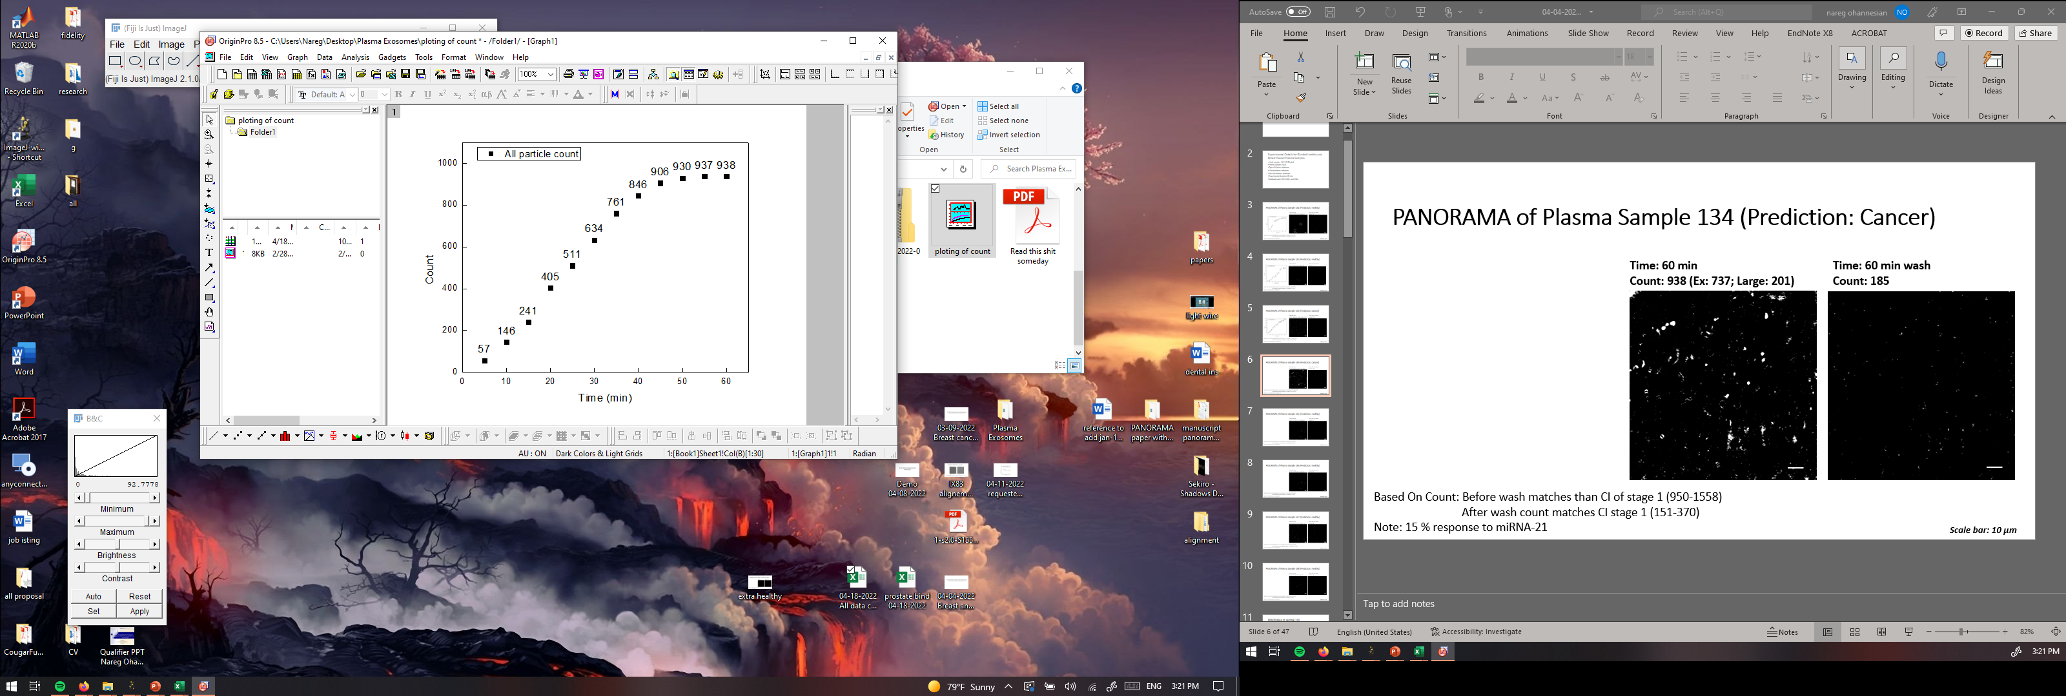
PANORAMA of Plasma Sample 134 (Prediction: Cancer)
Time: 60 min
Count: 938 (Ex: 737; Large: 201)
Time: 60 min wash
Count: 185
Based On Count: Before wash matches than CI of stage 1 (950-1558)
After wash count matches CI stage 1 (151-370)
Note: 15 % response to miRNA-21
Scale bar: 10 µm

Slide 7
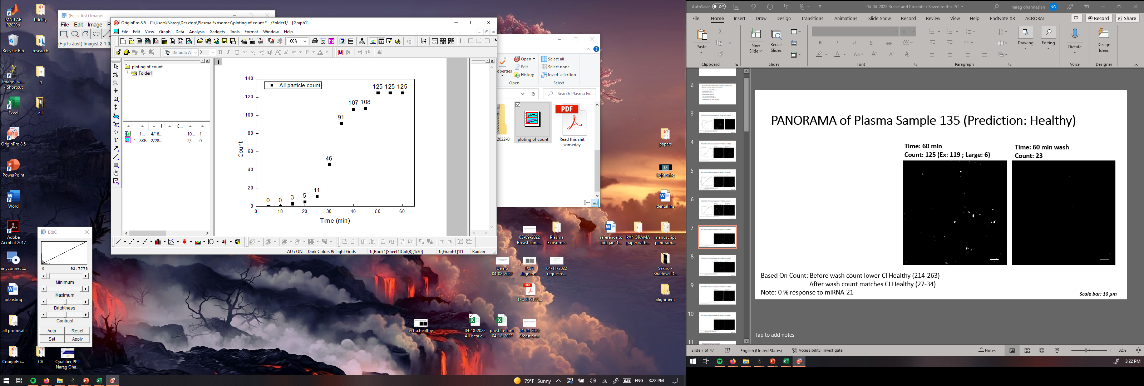
PANORAMA of Plasma Sample 135 (Prediction: Healthy)
Time: 60 min
Count: 125 (Ex: 119 ; Large: 6)
Time: 60 min wash
Count: 23
Based On Count: Before wash count lower CI Healthy (214-263)
After wash count matches CI Healthy (27-34)
Note: 0 % response to miRNA-21
Scale bar: 10 µm

Slide 8

PANORAMA of Plasma Sample 136 (Prediction: Healthy)
Time: 60 min
Count: 139 (Ex: 89 ; Large: 50)
Time: 60 min wash
Count: 34
Based On Count: Before wash count lower CI Healthy (214-263)
After wash count matches CI Healthy (27-34)
Note: 0 % response to miRNA-21
Scale bar: 10 µm

Slide 9
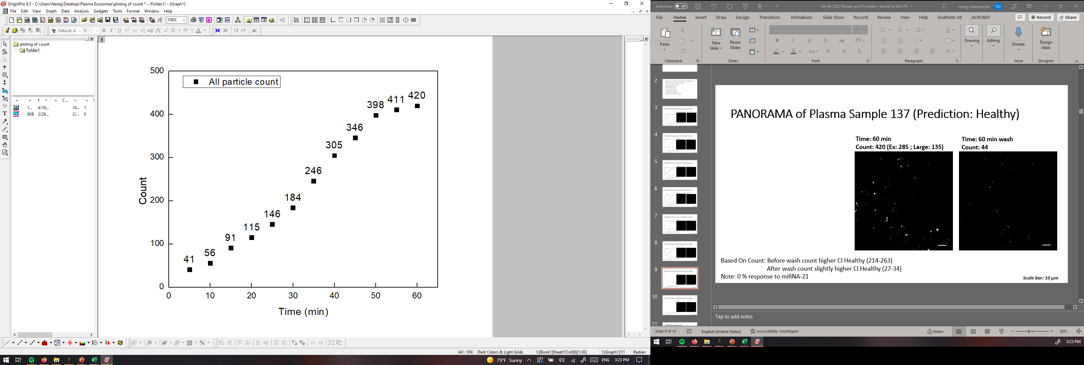
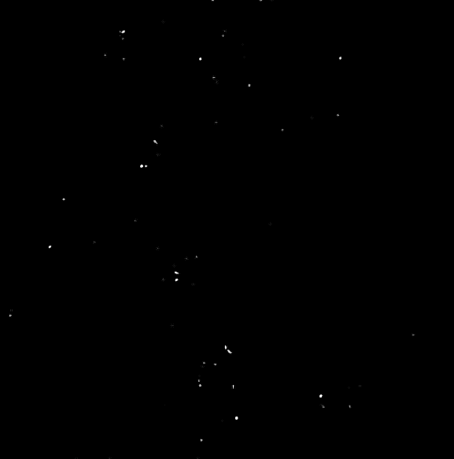
PANORAMA of Plasma Sample 137 (Prediction: Healthy)
Time: 60 min
Count: 420 (Ex: 285 ; Large: 135)
Time: 60 min wash
Count: 44
Based On Count: Before wash count higher CI Healthy (214-263)
After wash count slightly higher CI Healthy (27-34)
Note: 0 % response to miRNA-21
Scale bar: 10 µm

Slide 10
Unblinding
 | Before wash |  |  | After Wash
Number | All particles | Large | Ex like | Retained | MIR-21 (%) | Prediction | Actual state | Sample
131 | 125 | 6 | 119 | 23 | 0 | Healthy | Healthy | HCR 49
132 | 96 | 14 | 82 | 17 | 0 | Healthy | Healthy | HCR 29
133 | 1690 | 181 | 1509 | 236 | 55 | Cancer | Cancer | 362-7A
134 | 938 | 201 | 737 | 185 | 15 | Cancer | Cancer | 362-8A
135 | 120 | 14 | 106 | 19 | 0 | Healthy | Healthy | HCR 34
136 | 139 | 50 | 89 | 34 | 0 | Healthy | Healthy | HCR 21
137 | 420 | 135 | 285 | 44 | 0 | Healthy | Healthy | HCR 20

Slide 11
Experimental Details for Blinded Prostate Plasma Samples (Set 0514)
Used samples:
Plasma volume: 20 µl.
Type of Cancer: unknown.
Concentration: unknown.
Size Distribution: unknown.
Experimental duration: 60 min.
Antibody used: CD9, CD81, and CD63.

Slide 12
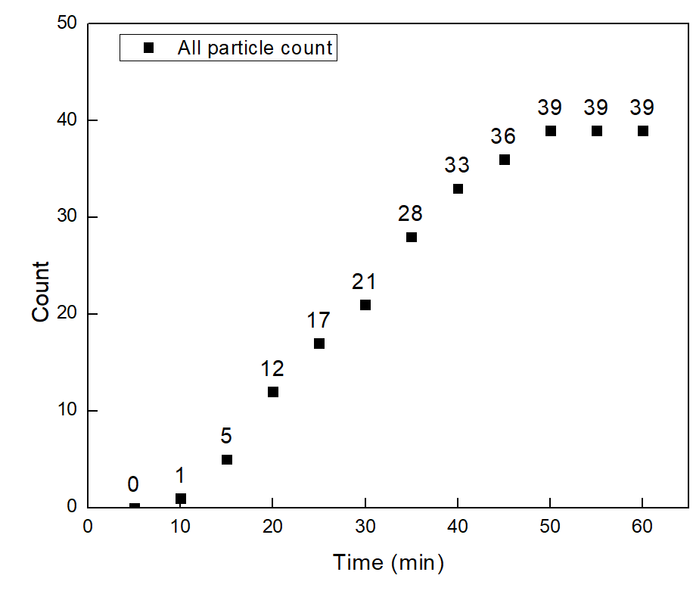
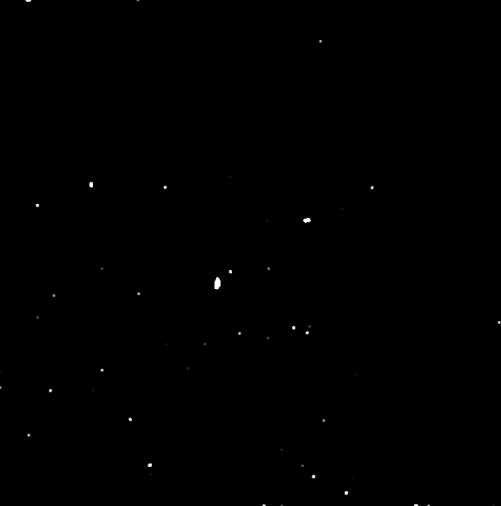
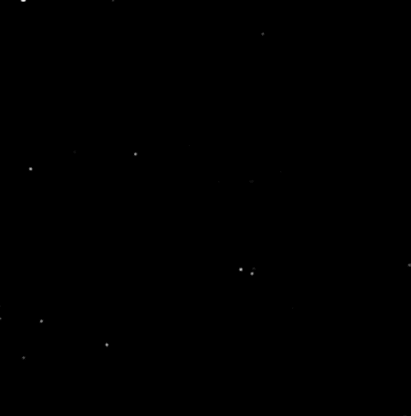
PANORAMA of Plasma Sample 138 (Prediction: Healthy)
Time: 60 min
Count: 39 (Ex: 34 ; Large: 5)
Time: 60 min wash
Count: 14
Based On Count: Before wash count higher CI Healthy (214-263)
After wash count lower CI Healthy (27-34)
Note: 0 % response to miRNA-21
Scale bar: 10 µm

Slide 13
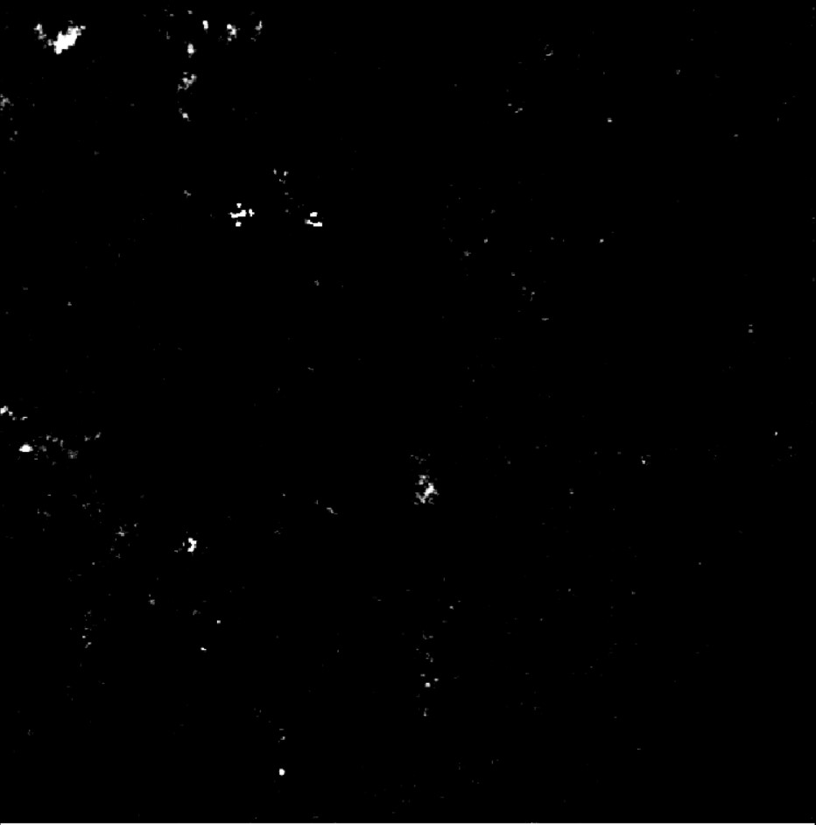
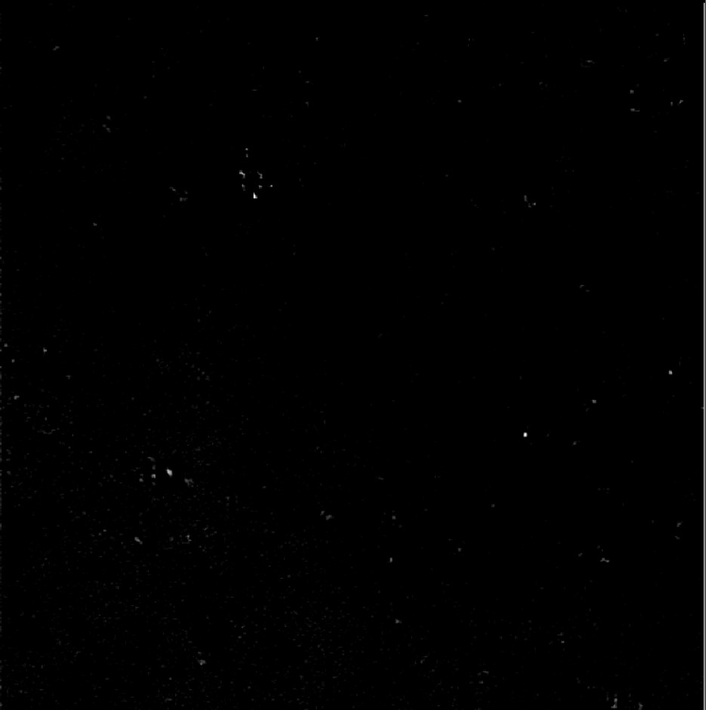
PANORAMA of sample 139 (Prediction: Healthy)
Before wash particles: 155
Large particle: 18
Exosome: 137
Note: 0% response to miRNA-21
Looks healthy
After wash exosome: 50
Scale Bar: 10 µm

Slide 14

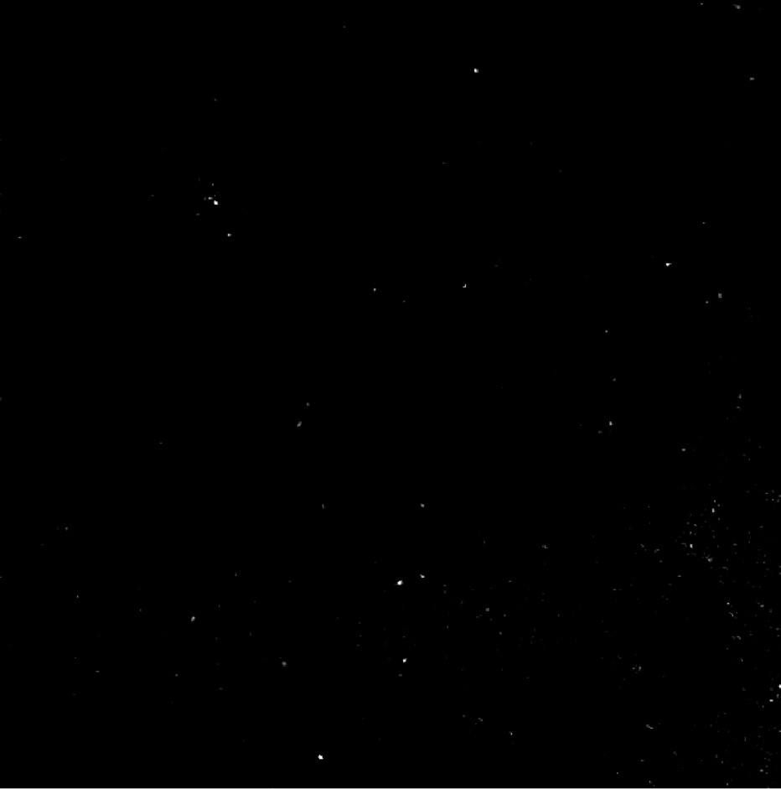
PANORAMA of sample 140 (Prediction: Cancer )
Note: 0% response to miRNA-21
Looks cancerous
Before wash particles: 281
Large particle: 24
Exosome: 257
After wash exosome: 99
Scale Bar: 10 µm

Slide 15
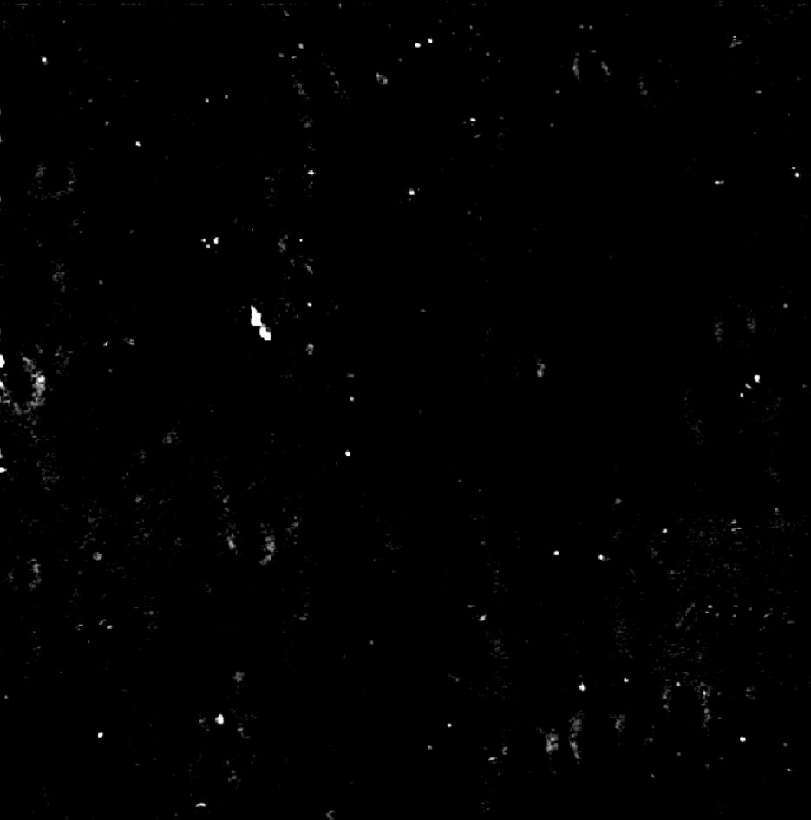

PANORAMA of sample 141 (Prediction: Cancer )
Before wash particles: 368
Large particle: 30
Exosome: 338
After wash exosome: 122
Note: 22% response to miRNA-21
Looks cancerous
Scale Bar: 10 µm

Slide 16
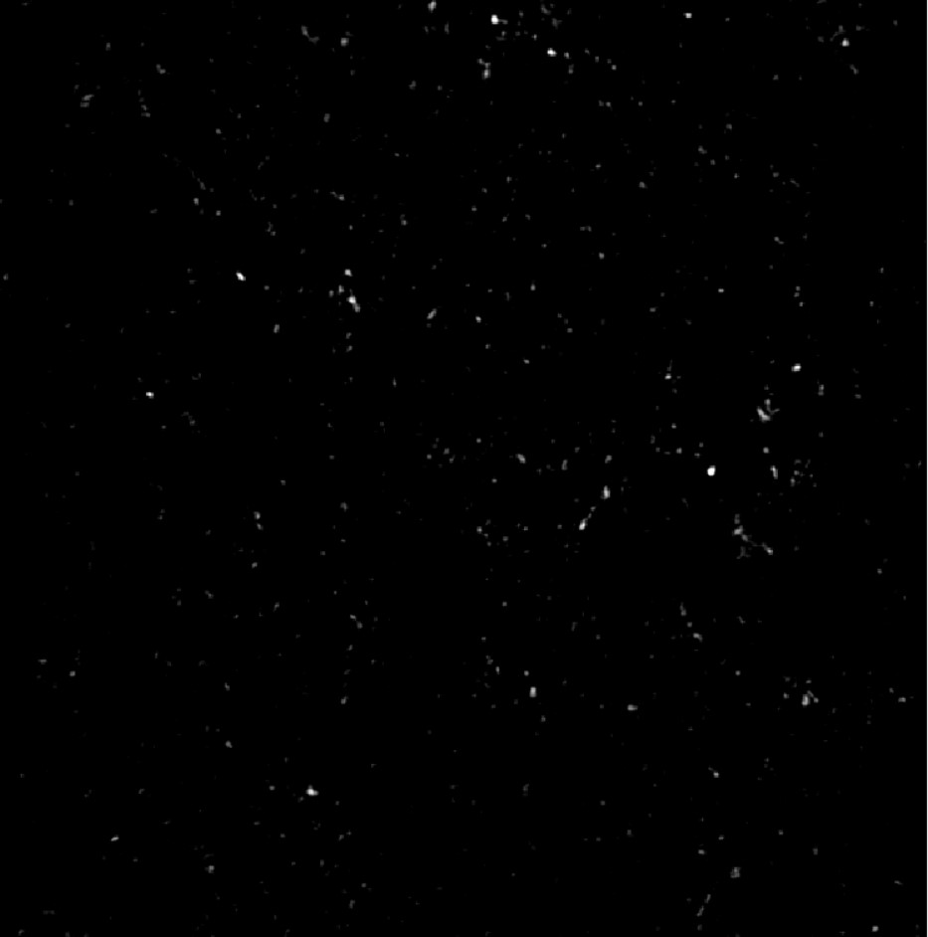
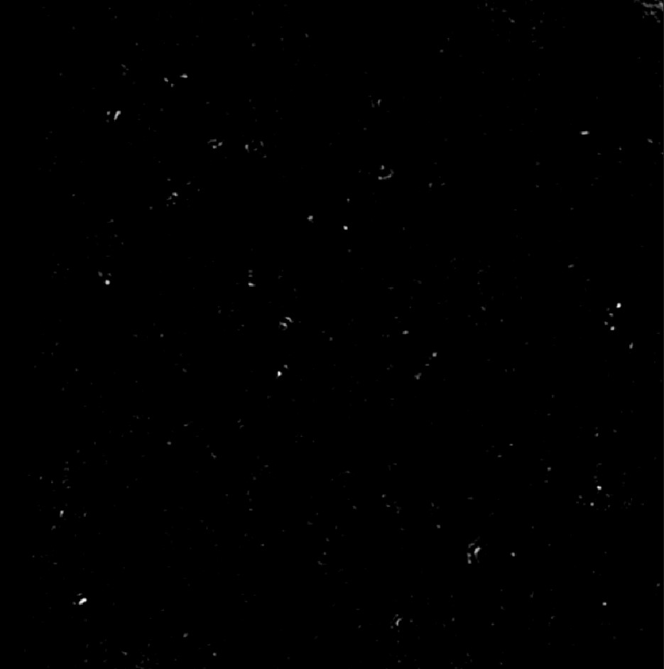
PANORAMA of sample 142 (Prediction: Cancer )
Before wash particles: 539
Large particle: 27
Exosome: 512
After wash exosome:153
Note: 37% response to miRNA-21
Looks cancerous
Scale Bar: 10 µm

Slide 17
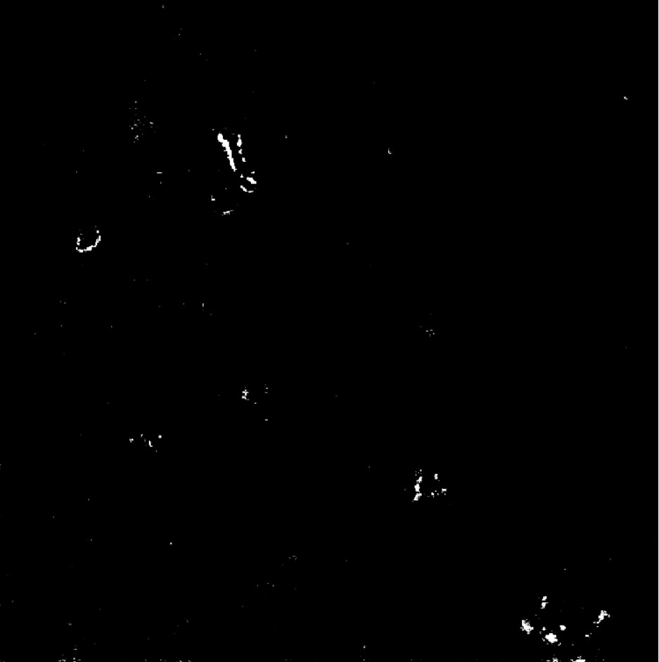
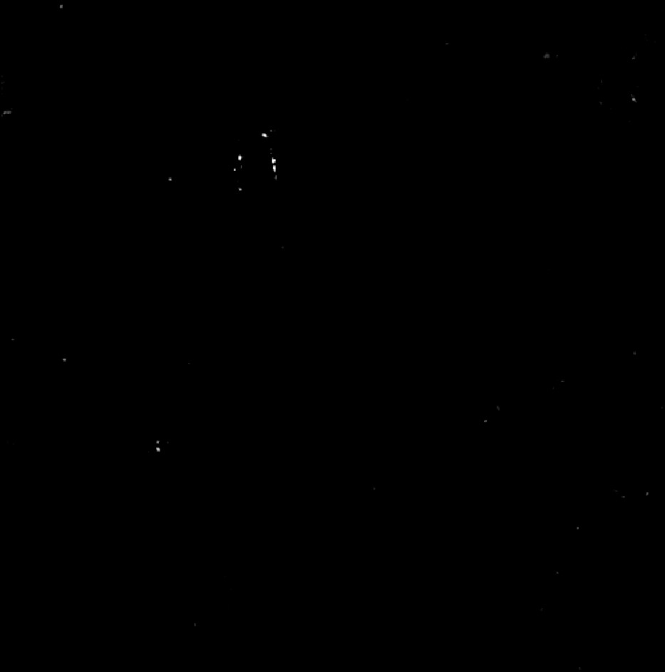
PANORAMA of sample 143 (Prediction: Healthy)
Before wash particles: 113
Large particle: 17
Exosome: 96
After wash exosome: 33
Note: 0% response to miRNA-21
Looks healthy
Scale Bar: 10 µm

Slide 18
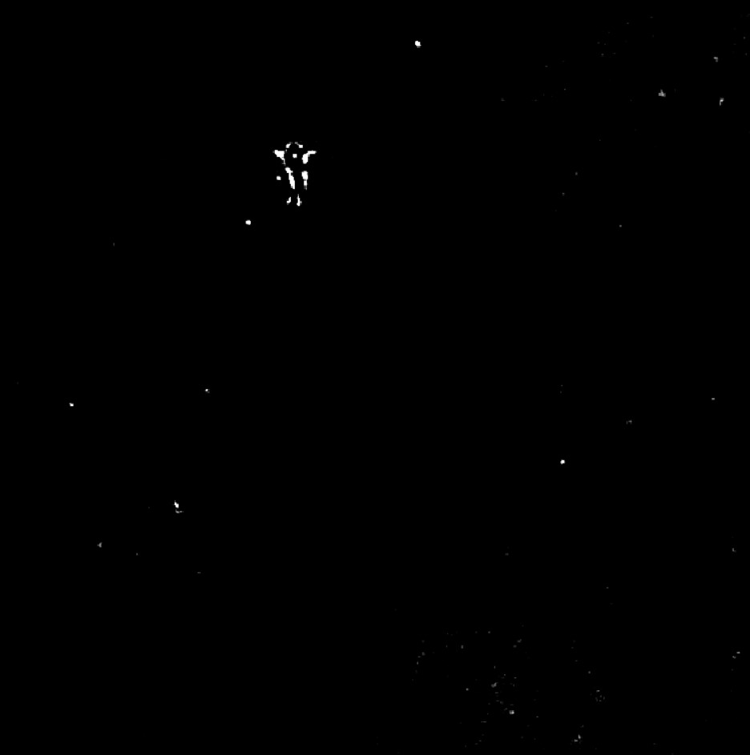

PANORAMA of sample 144 (Prediction: Healthy)
Before wash particles: 135
Large particle: 16
Exosome: 119
After wash exosome: 49
Note: 0% response to miRNA-21
Looks healthy
Scale Bar: 10 µm

Slide 19
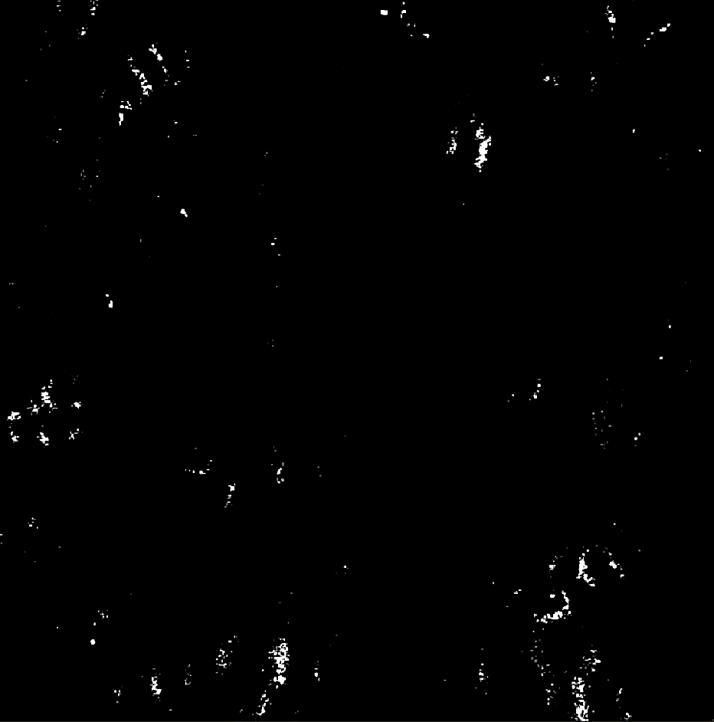
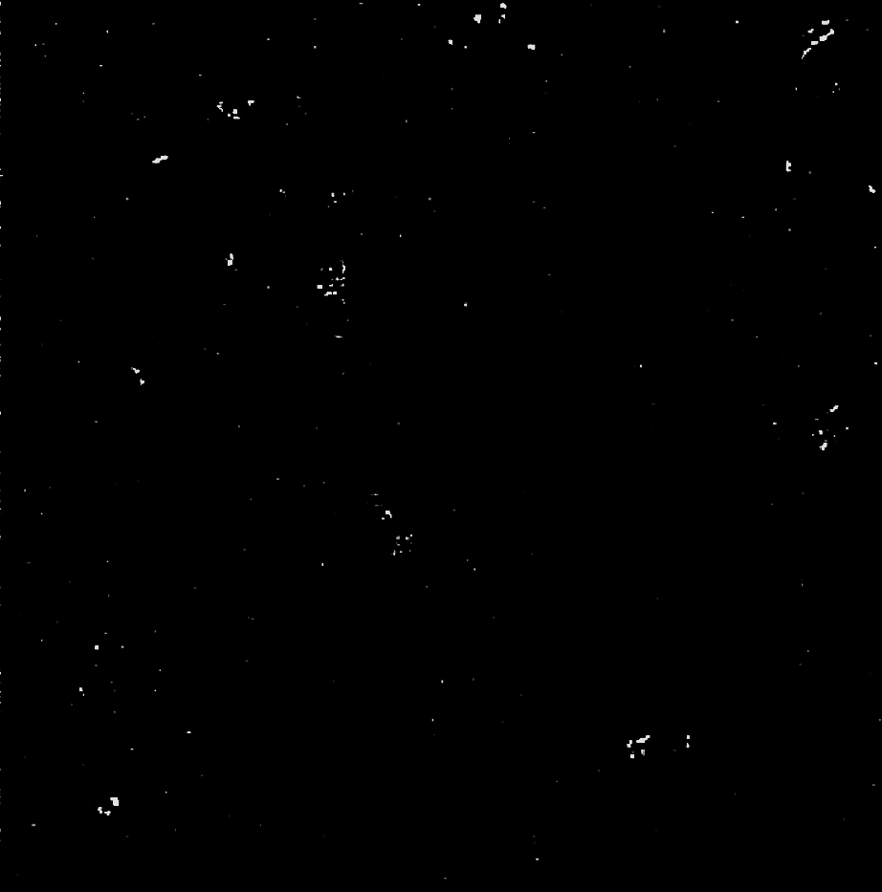
PANORAMA of sample 145 (Prediction: Cancer )
Before wash particles: 477
Large particle: 47
Exosome: 430
After wash exosome: 260
Note: 23% response to miRNA-21
Looks cancerous
Scale Bar: 10 µm

Slide 20
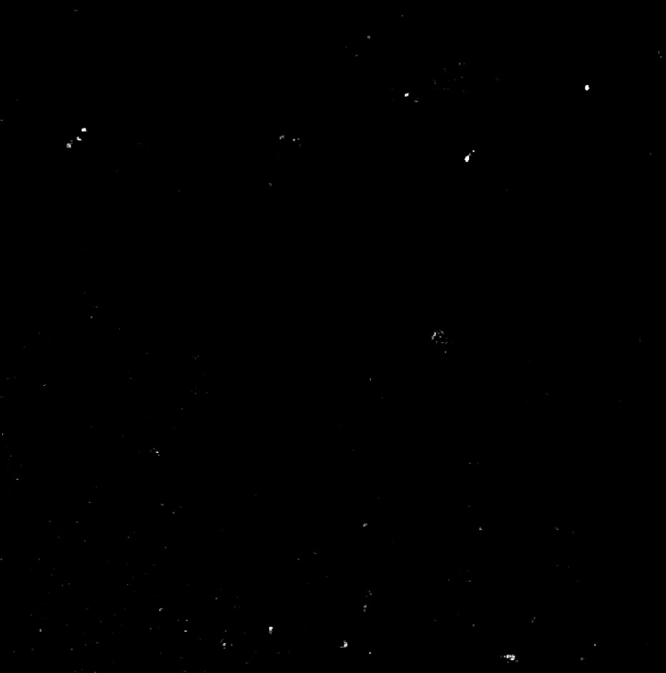
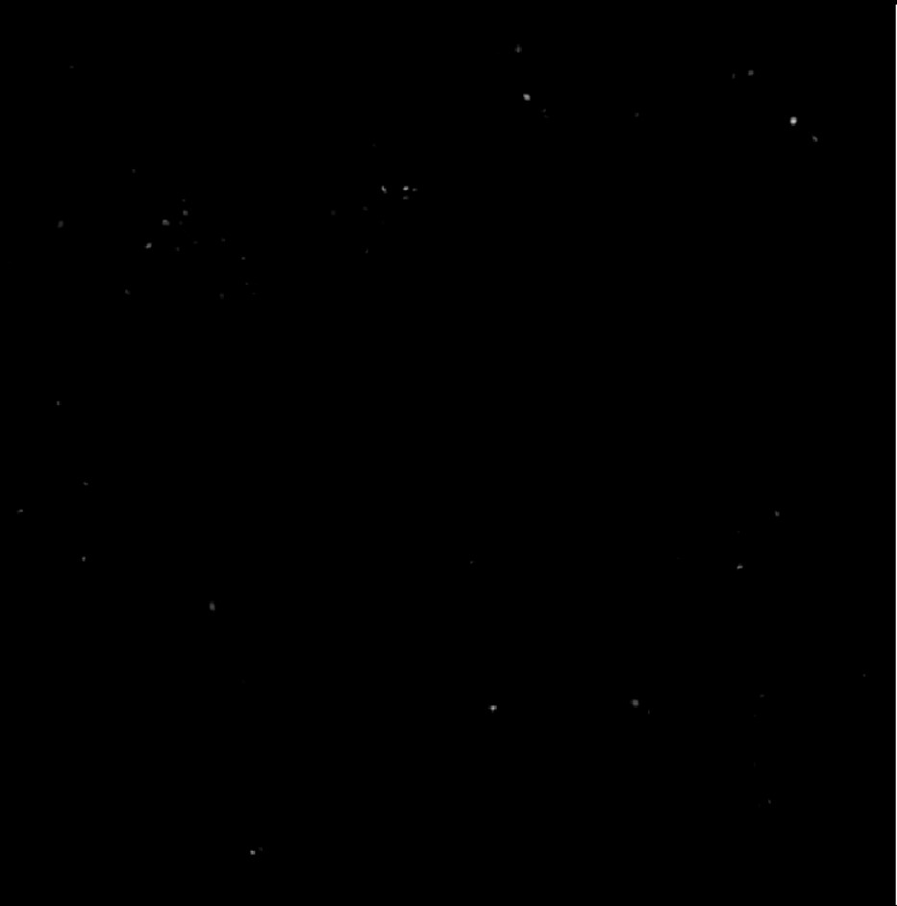
PANORAMA of sample 146 (Prediction: Healthy)
Before wash particles: 171
Large particle: 13
Exosome: 158
After wash exosome: 57
Note: 0% response to miRNA-21
Looks healthy
Scale Bar: 10 µm

Slide 21
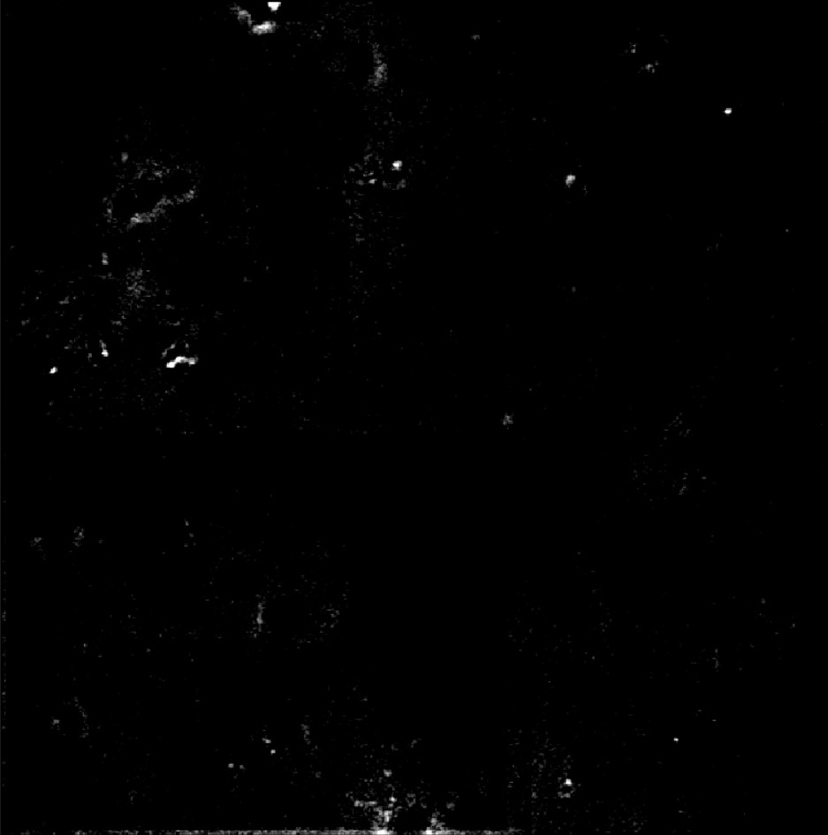
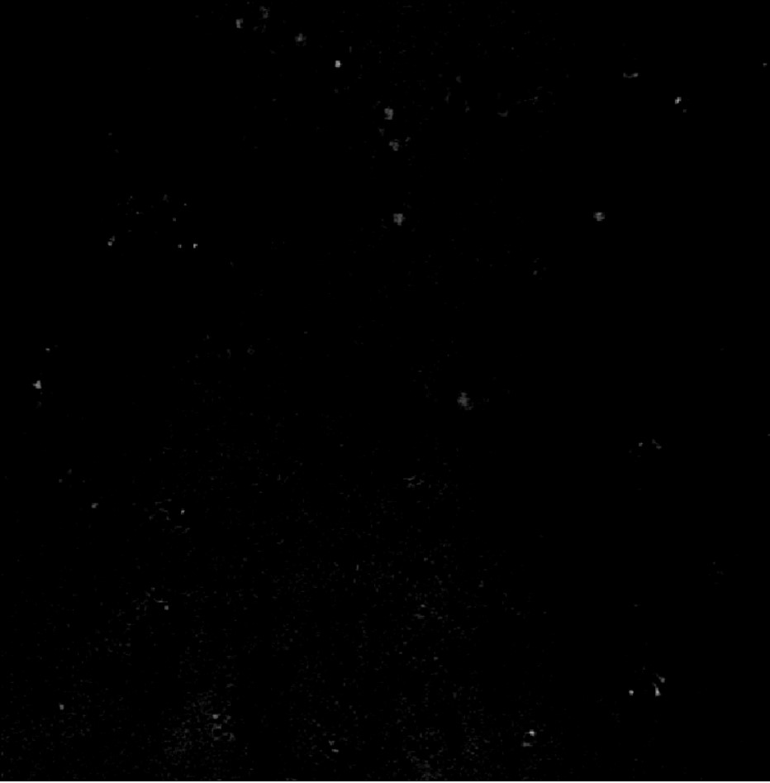
PANORAMA of sample 147 (Prediction: Healthy)
Before wash particles: 287
Large particle: 26
Exosome: 261
After wash exosome: 60
Note: 0% response to miRNA-21
Looks healthy
Scale Bar: 10 µm

Slide 22
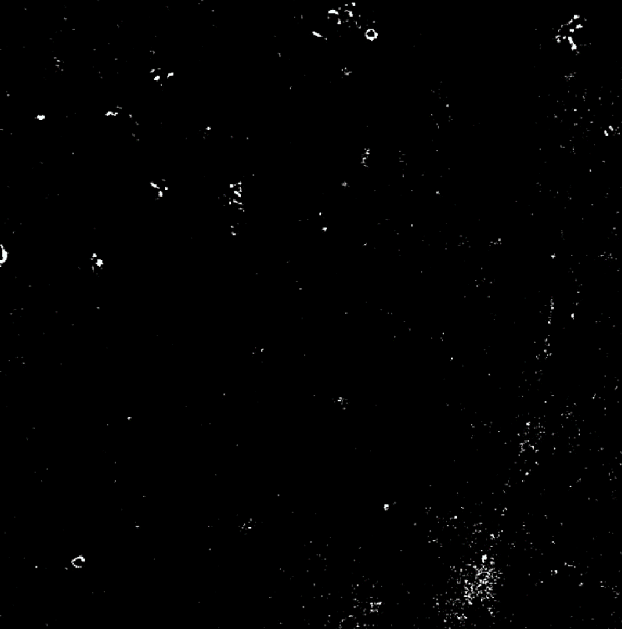
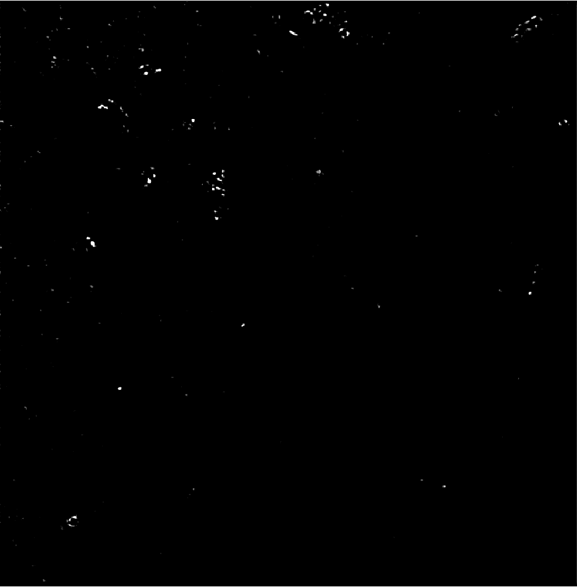
PANORAMA of sample 148 (Prediction: Cancer )
Before wash particles: 341
Large particle: 27
Exosome: 314
After wash exosome: 132
Note: 17% response to miRNA-21
Looks cancerous
Scale Bar: 10 µm

Slide 23
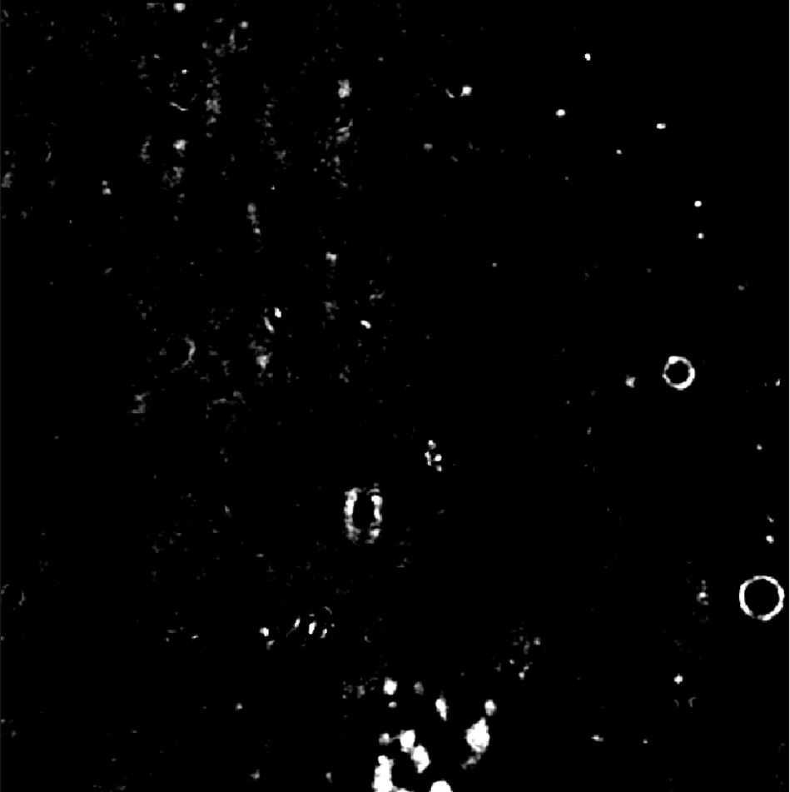

Image of Detected Particles via PANORAMA (149)
Time: 60 min
Count: 192 (Ex: 159; Large: 33)
Time: 60 min wash
Count: 64
Based On Count: Before wash count matches CI Healthy (64-172)
After wash count higher than 99% CI Healthy (5-35) but lower than 70
Note: 0 % response to miRNA-21
Look healthy
Scale Bar: 10 µm

Slide 24
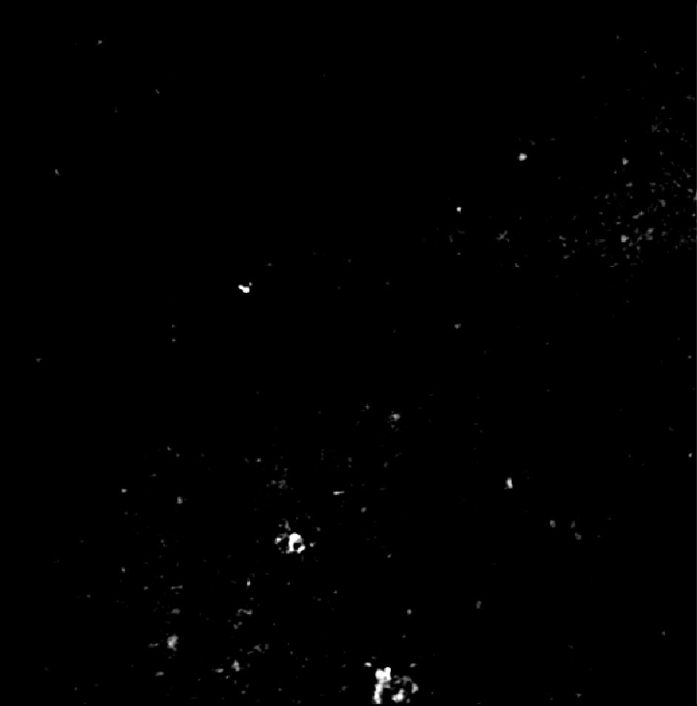
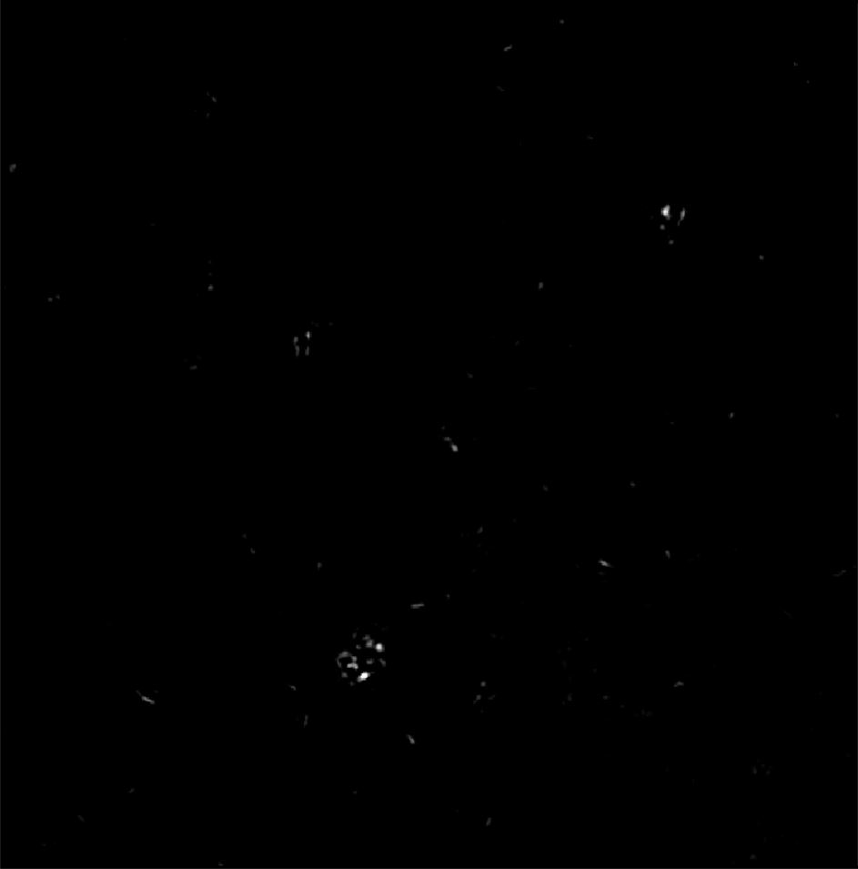
Image of Detected Particles via PANORAMA (150)
Time: 60 min
Count: 144 (Ex: 121; Large: 23)
Time: 60 min wash
Count: 56
Based On Count: Before wash count matches CI Healthy (64-172)
After wash count higher than 99% CI Healthy (5-35) but lower than 70
Note: 0% response to miRNA-21
Look healthy
Scale Bar: 10 µm

Slide 25
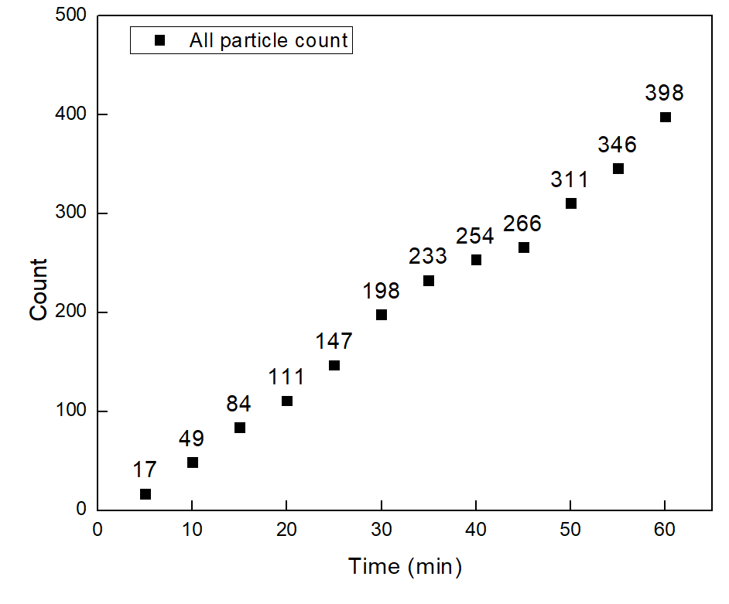
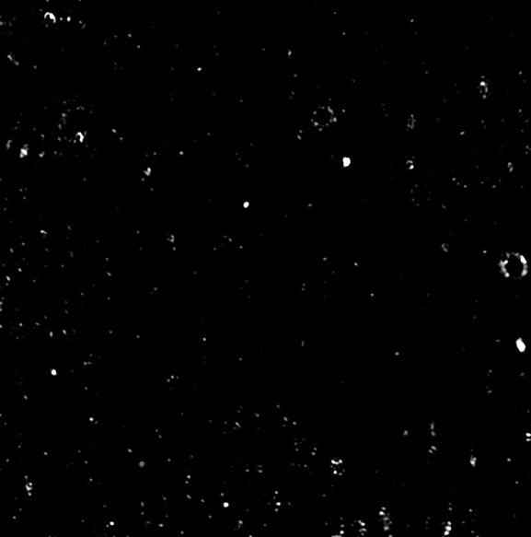

PANORAMA of Plasma Sample 151 (Prediction: Cancer )
Time: 60 min
Count: 398 (Ex: 329; Large: 69)
Time: 60 min wash
Count: 192
Based On Count: Before wash lower CI of stage 1 (950-1558)
After wash matches CI stage 1 (151-370)
Note: 0% response to miRNA-21
Scale bar: 10 µm

Slide 26
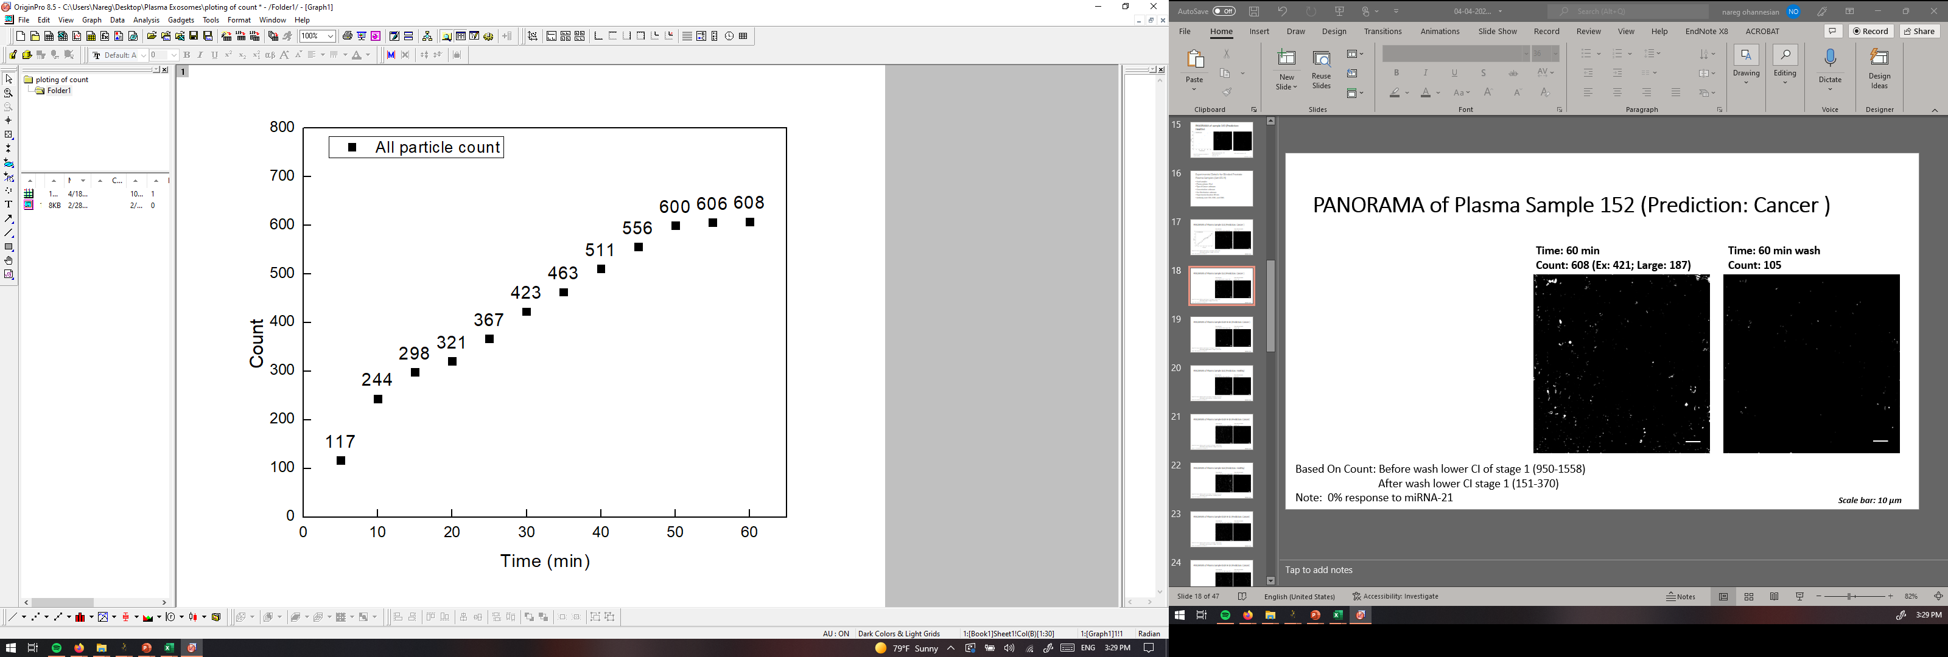

PANORAMA of Plasma Sample 152 (Prediction: Cancer )
Time: 60 min
Count: 608 (Ex: 421; Large: 187)
Time: 60 min wash
Count: 105
Based On Count: Before wash lower CI of stage 1 (950-1558)
After wash lower CI stage 1 (151-370)
Note: 0% response to miRNA-21
Scale bar: 10 µm

Slide 27
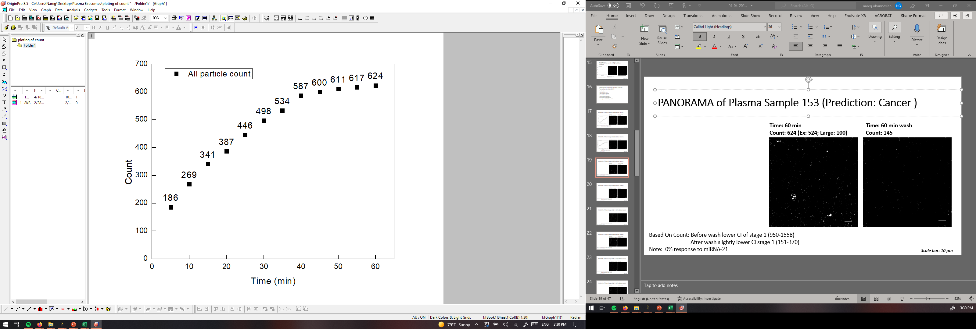
PANORAMA of Plasma Sample 153 (Prediction: Cancer )
Time: 60 min
Count: 624 (Ex: 524; Large: 100)
Time: 60 min wash
Count: 145
Based On Count: Before wash lower CI of stage 1 (950-1558)
After wash slightly lower CI stage 1 (151-370)
Note: 0% response to miRNA-21
Scale bar: 10 µm

Slide 28

PANORAMA of Plasma Sample 154 (Prediction: Healthy)
Time: 60 min
Count: 300 (Ex: 238; Large: 62)
Time: 60 min wash
Count: 43
Based On Count: Before wash count lower CI Healthy (214-263)
After wash count matches CI Healthy (24-34)
Note: 0 % response to miRNA-21
Scale bar: 10 µm

Slide 29
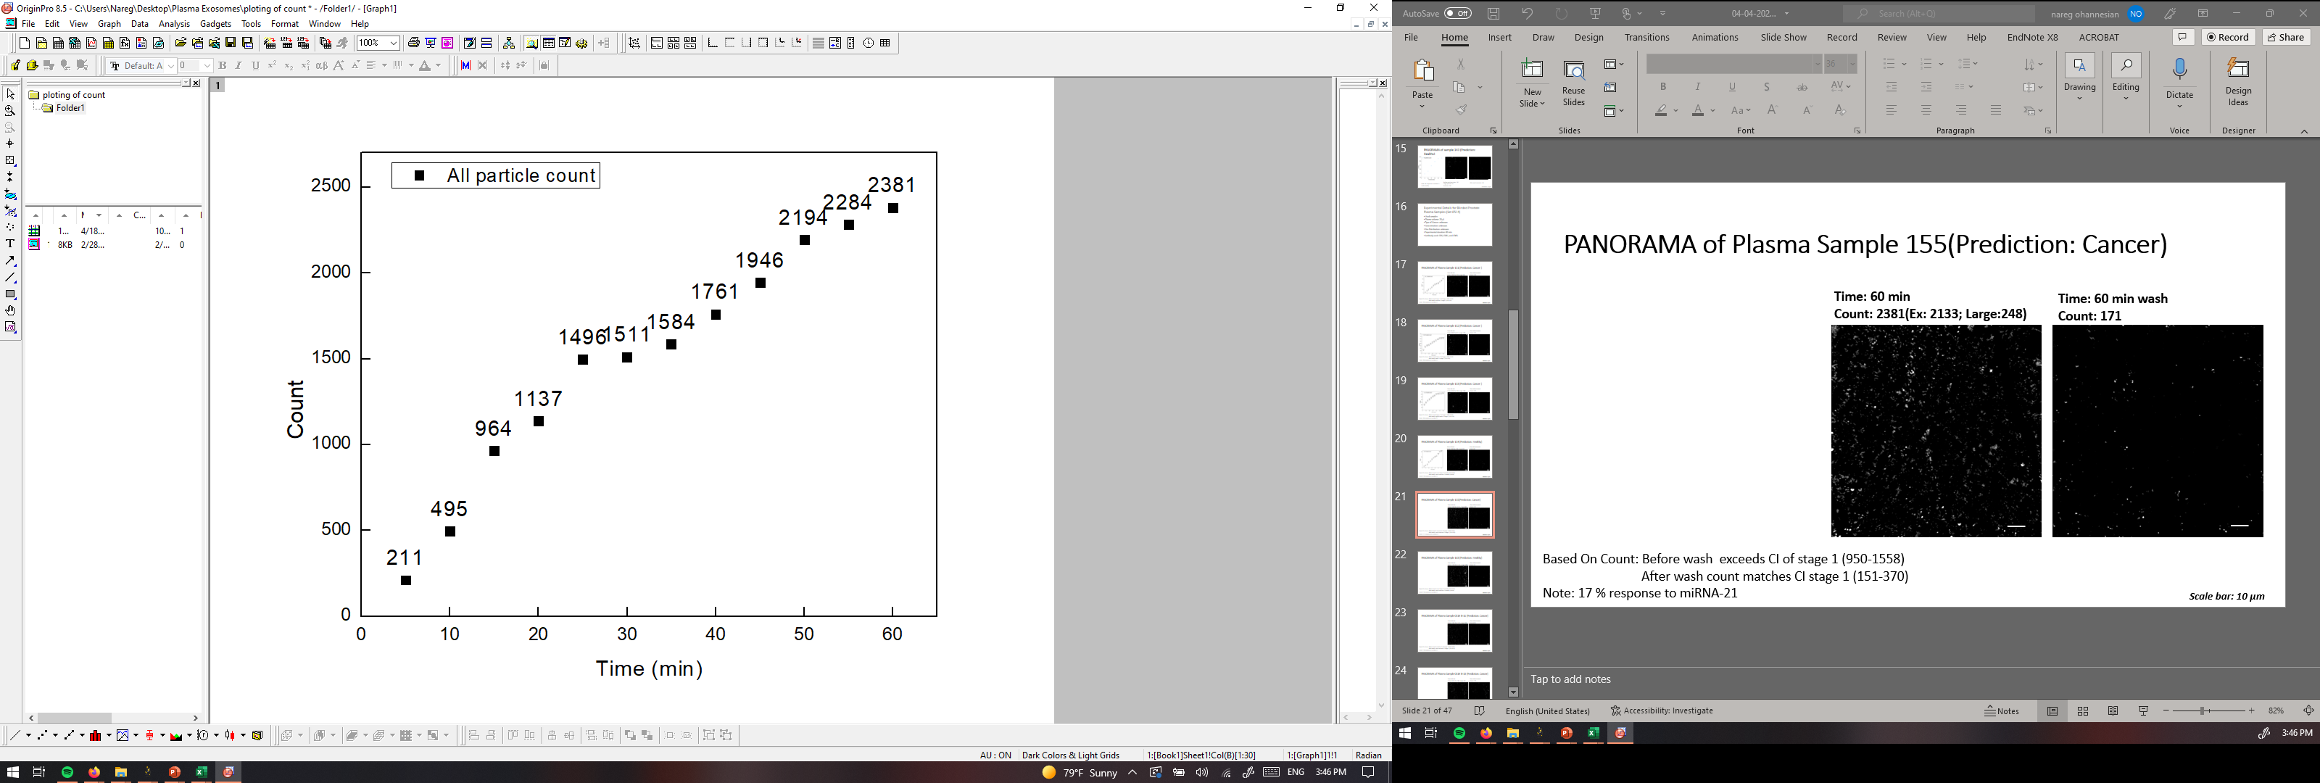

PANORAMA of Plasma Sample 155(Prediction: Cancer)
Time: 60 min
Count: 2381(Ex: 2133; Large:248)
Time: 60 min wash
Count: 171
Based On Count: Before wash exceeds CI of stage 1 (950-1558)
After wash count matches CI stage 1 (151-370)
Note: 17 % response to miRNA-21
Scale bar: 10 µm

Slide 30

PANORAMA of Plasma Sample 156 (Prediction: Healthy)
Time: 60 min
Count: 1358 (Ex: 1113 ; Large: 245)
Time: 60 min wash
Count: 35
Based On Count: Before wash count lower CI Healthy (214-263)
After wash count matches CI Healthy (24-34)
Note: 0 % response to miRNA-21
Scale bar: 10 µm

Slide 31


PANORAMA of Plasma Sample 157 (Prediction: Cancer)
Time: 60 min
Count: 1501 (Ex: 1321; Large:180)
Time: 60 min wash
Count:439
Based On Count: Before wash matches CI of stage 1 (950-1558)
After wash count exceeds CI stage 1 (151-370)
Note: 3 % response to miRNA-21
Scale bar: 10 µm

Slide 32
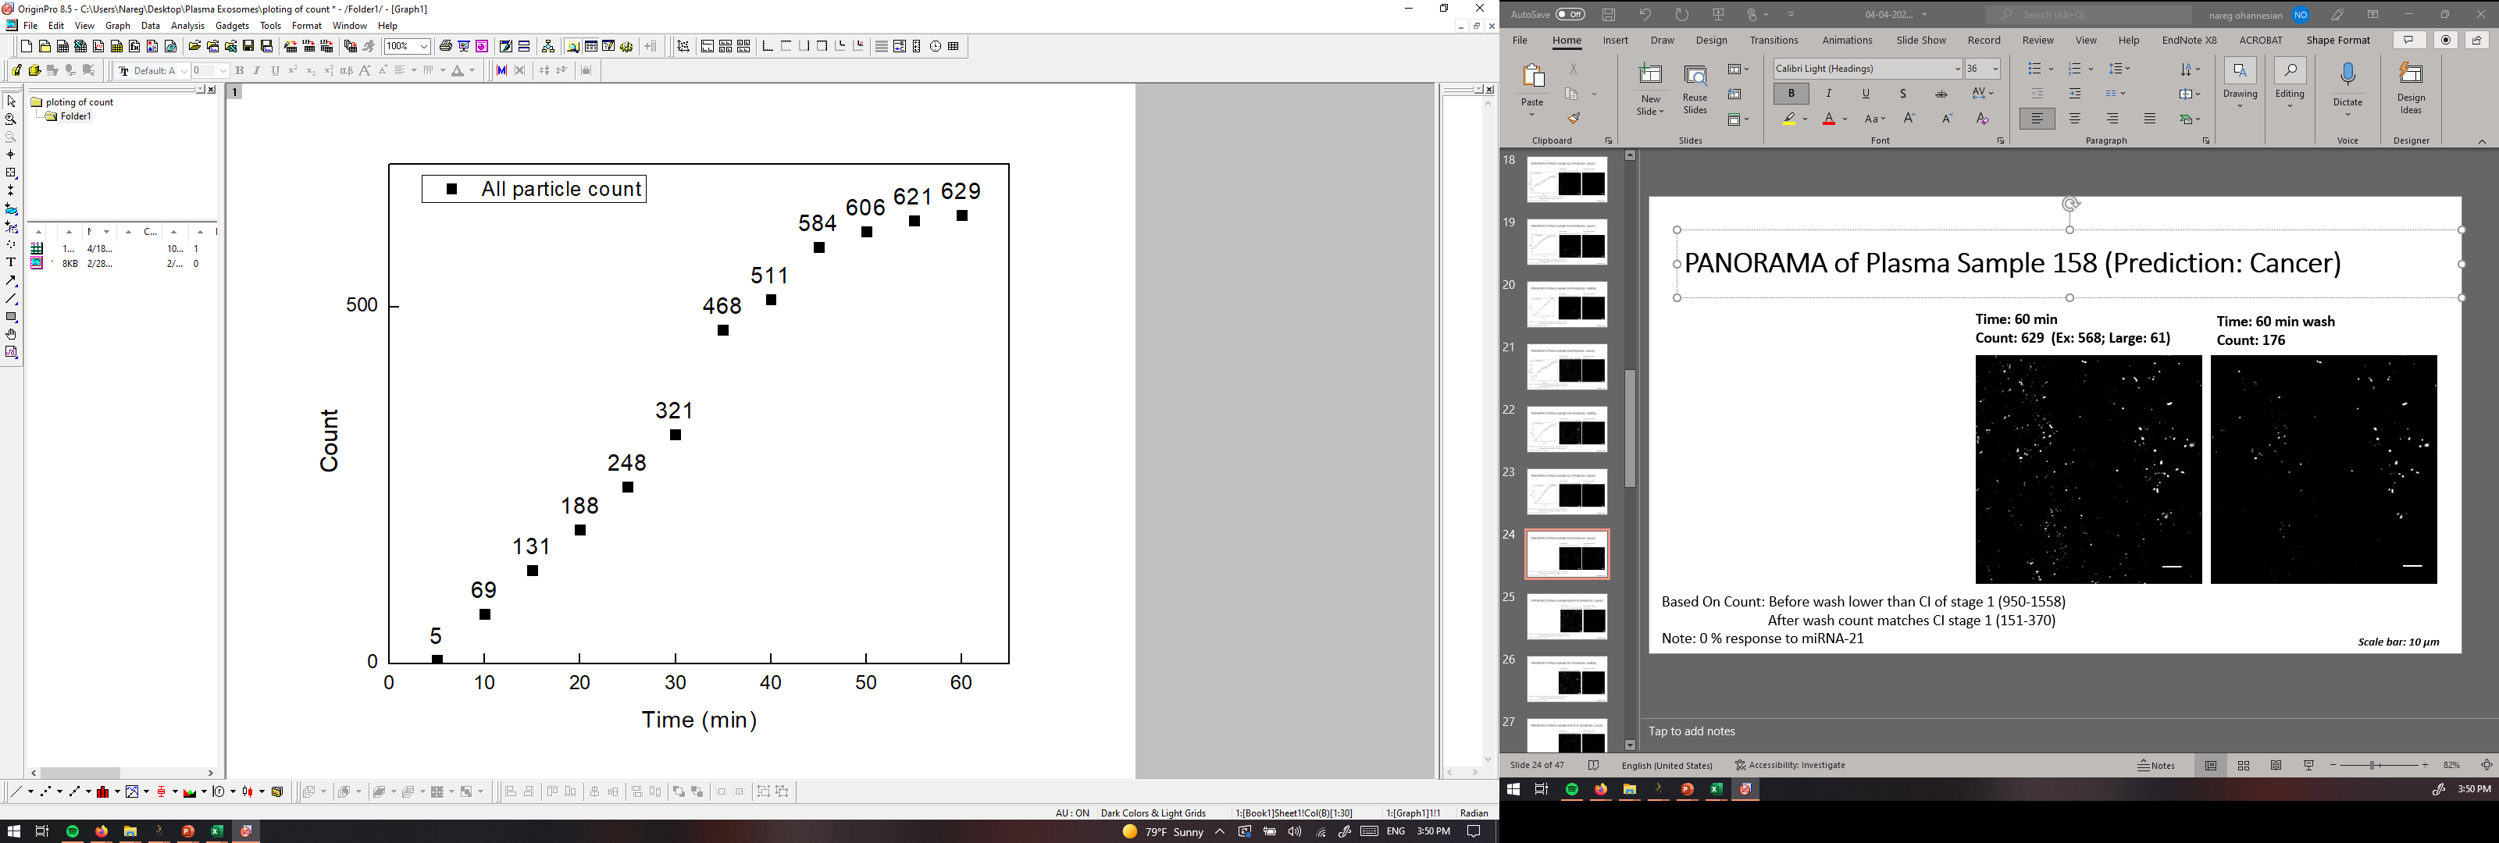
PANORAMA of Plasma Sample 158 (Prediction: Cancer)
Time: 60 min
Count: 629 (Ex: 568; Large: 61)
Time: 60 min wash
Count: 176
Based On Count: Before wash lower than CI of stage 1 (950-1558)
After wash count matches CI stage 1 (151-370)
Note: 0 % response to miRNA-21
Scale bar: 10 µm

Slide 33
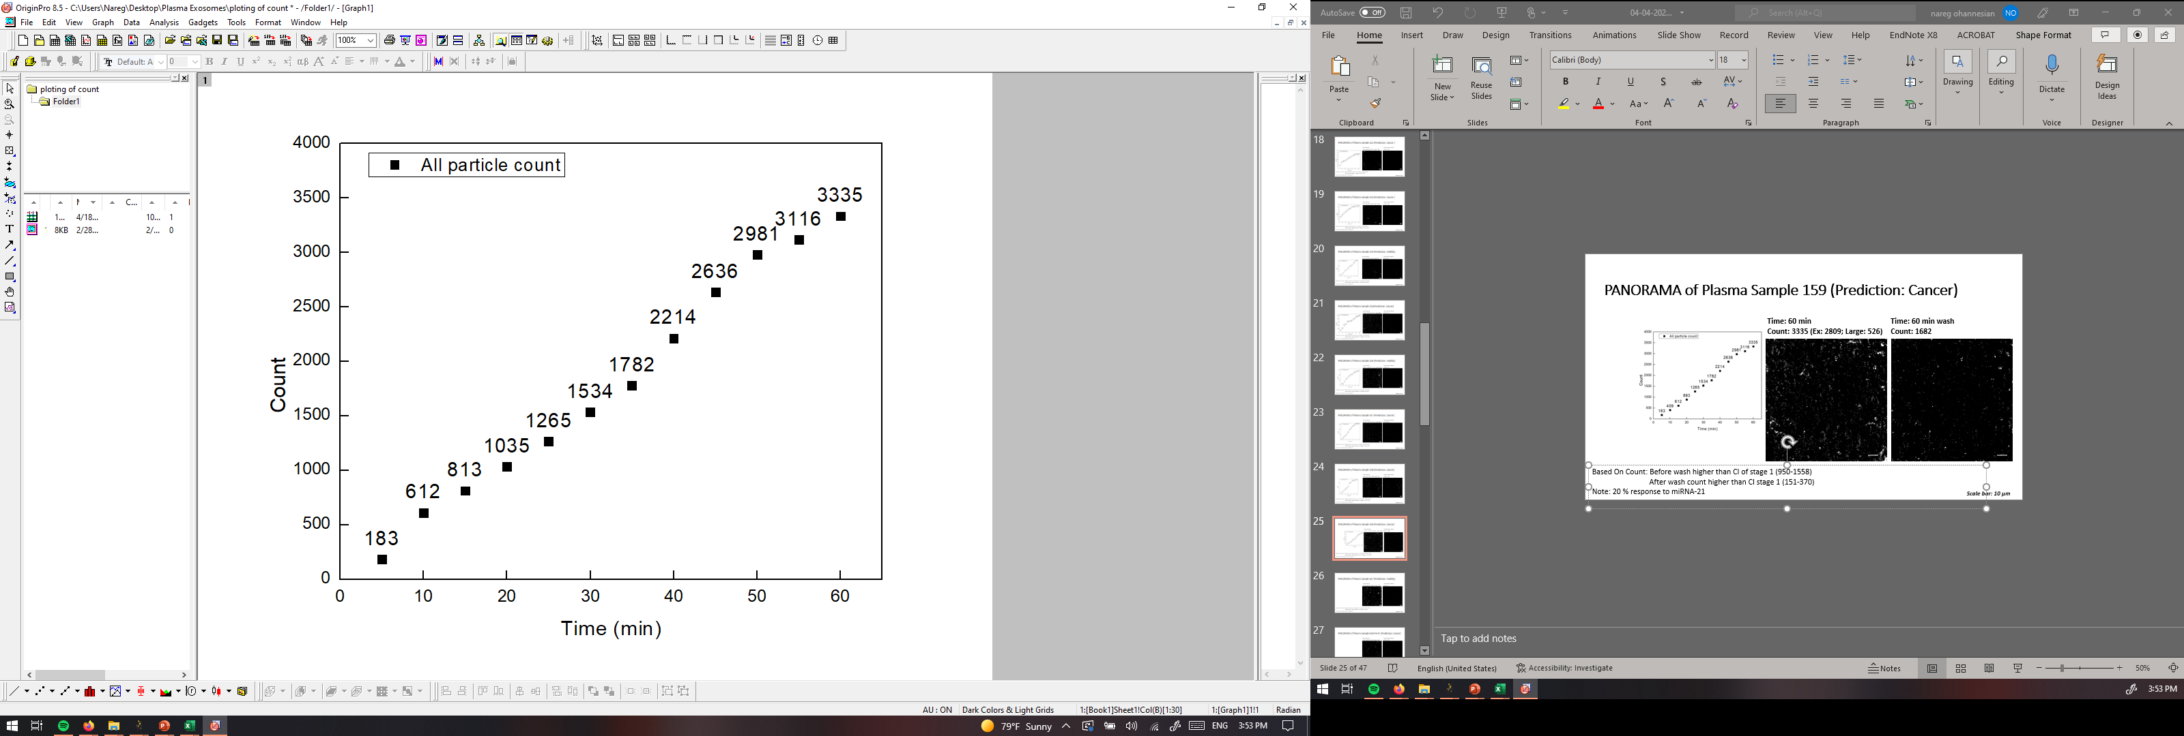
PANORAMA of Plasma Sample 159 (Prediction: Cancer)
Time: 60 min
Count: 3335 (Ex: 2809; Large: 526)
Time: 60 min wash
Count: 1682
Based On Count: Before wash higher than CI of stage 1 (950-1558)
After wash count higher than CI stage 1 (151-370)
Note: 20 % response to miRNA-21
Scale bar: 10 µm

Slide 34
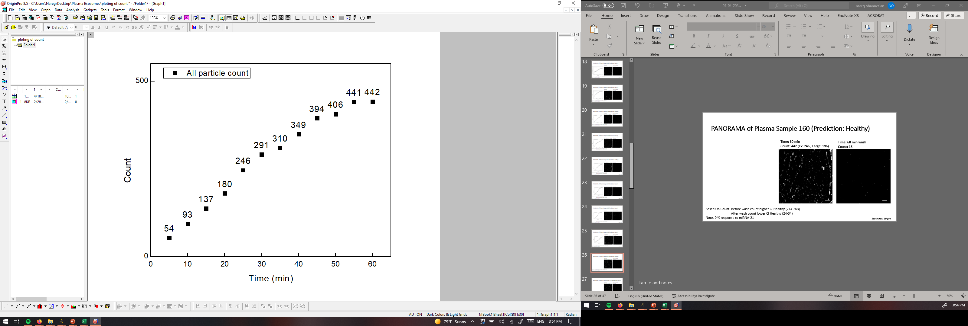
PANORAMA of Plasma Sample 160 (Prediction: Healthy)
Time: 60 min
Count: 442 (Ex: 246 ; Large: 196)
Time: 60 min wash
Count: 15
Based On Count: Before wash count higher CI Healthy (214-263)
After wash count lower CI Healthy (24-34)
Note: 0 % response to miRNA-21
Scale bar: 10 µm

Slide 35


PANORAMA of Plasma Sample 161 (Prediction: Cancer)
Time: 60 min
Count: 899 (Ex: 729; Large: 170)
Time: 60 min wash
Count: 187
Based On Count: Before wash slightly lower CI of stage 1 (950-1558)
After wash count matches CI stage 1 (151-370)
Note: 0% response to miRNA-21
Scale bar: 10 µm

